Slide 1

EEI4346 Web Technology Day School 02
H.R.S.Senanayake
Email: hrsen@ou.ac.lk CITES Faculty of Engineering Technology The Open University of Sri Lanka

Slide 2

Content
Programming Architecture
Web Protocols
Department of……………………………

Slide 3
Programming Architecture
Web application architecture defines the interactions between applications, middleware systems, and databases to ensure multiple applications can work together.
MVC
Onion
Model
View
Controller
Department of……………………………

Slide 4
What is MVC Architecture?
Stands for Model-View-Controller
A design pattern for developing software applications
Separates concerns and responsibilities into three distinct components
Department of……………………………

Slide 5
Model Component
Represents the application's data and logic
Handles data storage, retrieval, and manipulation
Independent of the user interface
Examples: database, data structures, business logic
Department of……………………………

Slide 6
View Component
Deals with the presentation and visualization of data
Displays information to the user
Receives input and sends it to the controller
Examples: HTML, CSS, UI templates, user interfaces
Department of……………………………

Slide 7
Controller Component
Mediates between the model and view
Receives user input from the view
Manipulates the model based on the input
Updates the view to reflect changes in the model
Examples: server-side scripts, application logic
Department of……………………………

Slide 8
MVC Interaction Flow
User interacts with the view (e.g., clicks a button)
View sends input to the controller
Controller processes the input and updates the model
Model notifies the view of changes
View updates its display based on the model's updates
Department of……………………………

Slide 9
MVC Benefits
Separation of concerns: Each component has a specific role
Code reusability: Components can be reused in different contexts
Parallel development: Different teams can work on different components simultaneously
Testability: Components can be independently tested
Flexibility: Changes in one component have minimal impact on the others
Department of……………………………

Slide 10
MVC Examples in Different Technologies
Web development: ASP.NET MVC, Ruby on Rails, Django
Desktop applications: Java Swing, Qt, Cocoa
Mobile app development: iOS (UIKit), Android (Android SDK)
Department of……………………………

Slide 11
Onion Architecture
The Onion Architecture, also known as Hexagonal Architecture, is an architectural pattern that promotes the separation of concerns and focuses on the independence of business logic from external frameworks and dependencies.
It was introduced by Jeffrey Palermo as an alternative to traditional layered architectures.
The Onion Architecture is a layered architectural pattern that organizes the components of a software system into concentric layers, each with a specific responsibility and level of abstraction.
Department of……………………………

Slide 12
Web UI/ Presentation
Application
Domain Service
Domain
Model / Infrastructure
Watch Me
Department of……………………………

Slide 13
Overview of the
Onion Architecture
Layers
Department of……………………………

Slide 14
Presentation Layer
User interfaces (UI), such as web interfaces, desktop applications, or APIs.
Handles user interactions and displays information to the user.
Communicates with the Application Layer.
Follows the Dependency Inversion Principle by depending on abstractions, not concrete implementations.
Department of……………………………

Slide 15
Responsibilities and Characteristics
Handles user input and output.
Focuses on the user experience and presentation of data.
Provides a separation between the user interface and the application's business logic.
Should be easily replaceable without affecting other layers.
Interaction with Application Layer:
Calls the appropriate application services or use cases to perform actions and retrieve data.
Department of……………………………

Slide 16
Application Layer
Contains application-specific business logic and use cases.
Orchestrates the interaction between the Presentation Layer and the Domain Layer.
Defines the application's behavior and coordinates the flow of data and actions.
Department of……………………………

Slide 17
Responsibilities and Characteristics
Contains the application-specific business logic.
Defines use cases and orchestrates the flow of actions.
Acts as an intermediary between the Presentation Layer and the Domain Layer.
Implements the application's behavior and business rules.
Business Logic:
Enforces business rules and validation.
Coordinates domain objects and services to execute use cases.
Handles complex interactions between entities and value objects.
Department of……………………………

Slide 18
Domain Layer
Core of the application, containing the domain model and business logic.
Represents the fundamental concepts, rules, and processes of the problem domain.
Encapsulates entities, value objects, domain services, and aggregates.
Department of……………………………

Slide 19
Responsibilities and Characteristics
Contains the core business logic and domain model.
Represents the fundamental concepts and rules of the problem domain.
Encapsulates entities, value objects, domain services, and aggregates.
Independent of frameworks, technologies, and infrastructure concerns.
Core Business Logic:
Implements domain-specific behavior and rules.
Represents the problem domain's concepts and processes accurately.
Focuses on solving the problem at hand rather than technical details.
Department of……………………………

Slide 20
Infrastructure Layer
Provides infrastructure-related functionality such as data access, external services integration, and persistence.
Implements interfaces defined in the Application and Domain Layers.
Dependencies on external frameworks and libraries reside in this layer.
Department of……………………………

Slide 21
Responsibilities and Characteristics
Provides infrastructure-related functionality required by the application.
Deals with data access, external services integration, and persistence concerns.
Implements interfaces defined in the Application and Domain Layers.
Contains external dependencies and frameworks.
External Dependencies:
Libraries, frameworks, databases, external APIs, file systems, etc.
Department of……………………………

Slide 22
Benefits of Onion Architecture
Modular and Maintainable Codebase:
Clear separation of concerns and loosely coupled layers facilitate maintainability.
Changes in one layer do not impact other layers, reducing the risk of regression bugs.
Improved Testability:
Each layer can be independently tested, facilitating unit testing and test-driven development (TDD).
Mocking dependencies becomes simpler due to the decoupled nature of layers.
Independence from Frameworks and External Dependencies:
The core business logic is independent of specific frameworks or technologies.
Easier to migrate or replace frameworks without affecting the application's behavior.
Flexibility and Extensibility:
The architecture enables easy integration of new features and functionalities.
Supports scalability and adaptability to changing business requirements.
Department of……………………………

Slide 23
Real-World Example
E-commerce Application:
Presentation Layer: Web-based UI with HTML, CSS, and JavaScript.
Application Layer: Implements use cases like product catalog management, order processing, and user authentication.
Domain Layer: Defines entities like Product, Order, and User with their associated business rules.
Infrastructure Layer: Integrates with external payment gateways, database systems, and email services.
Department of……………………………

Slide 24
Web Protocols
The Internet relies on a number of protocols in order to function properly. A protocol is simply a standard for enabling the connection, communication, and data transfer between two places on a network.
Department of……………………………

Slide 25
HTTP
HTTP stands for Hypertext Transfer Protocol
Protocol for transferring web pages (and their content) across the Internet
Ex: http://www.google.com/ - web browser to use HTTP to transfer the data
An application-level protocol for distributed, collaborative, hypermedia information systems
Department of……………………………

Slide 26
Basic Architecture
responds with a status line, including the message's protocol version and a success or error code
sends a request to the server in the form of a request method, URI, and protocol version
Web Server
Web Client
Server-Side Script
Database
HTTP Protocol
Department of……………………………

Slide 27
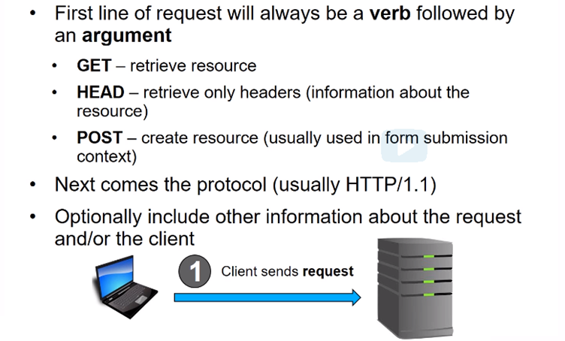
Anatomy of an HTTP request
Department of……………………………

Slide 28
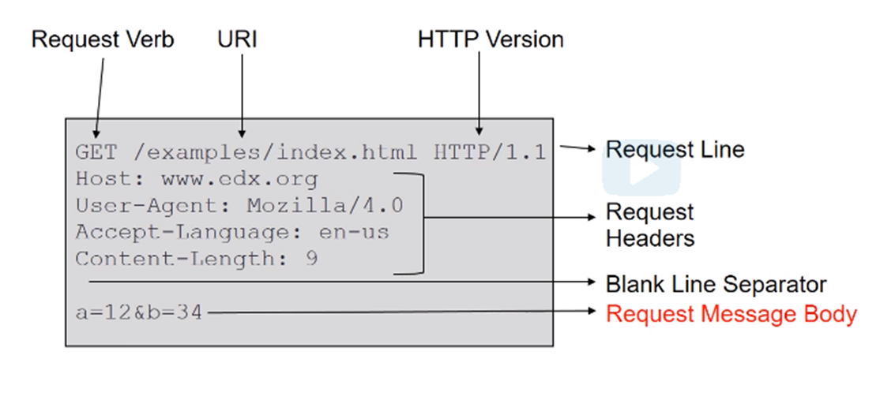
HTTP Request Example
Department of……………………………

Slide 29
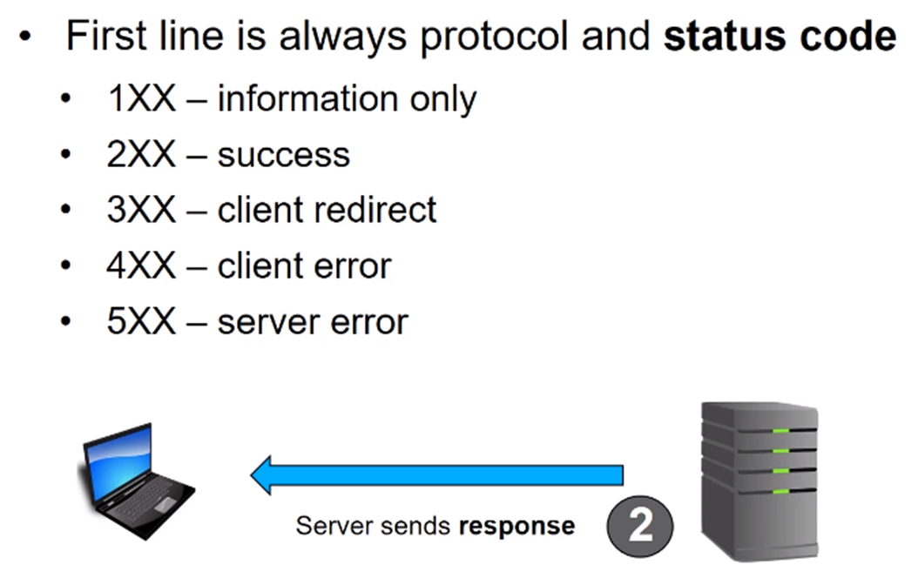
Anatomy of an HTTP Response
Department of……………………………

Slide 30
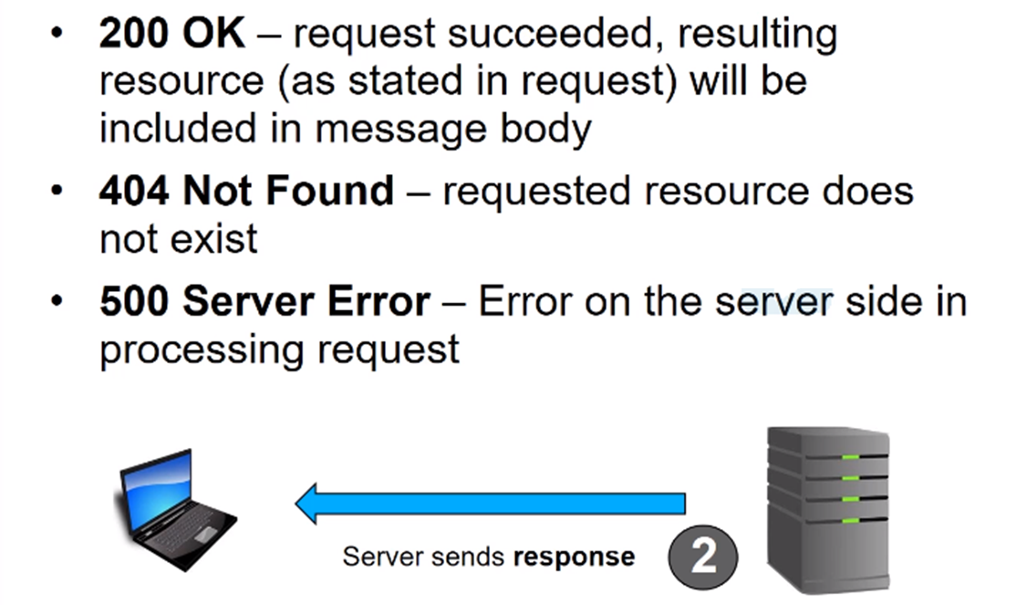
Status Code
Department of……………………………

Slide 31
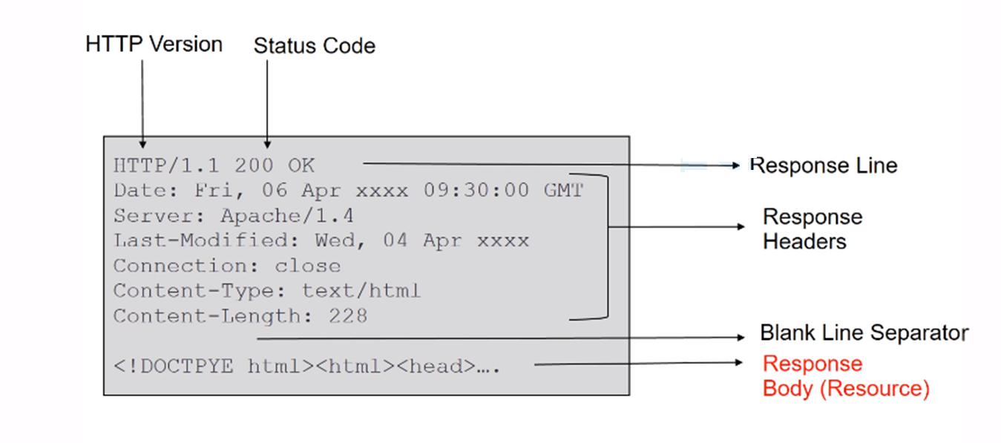
HTTP Response Example
Department of……………………………

Slide 32
HTTP Methods
GET
POST
PUT
HEAD
DELETE
PATCH
OPTIONS
There are many HTTP methods. But The two most common HTTP methods are GET and POST.
Department of……………………………

Slide 33
GET
Used to request data from a specified resource
Can be cached
Remain in the browser history
Can be bookmarked
Should never be used when dealing with sensitive data
Have length restrictions
Only used to request data (not modify)
POST
Used to send data to a server to create/update a resource
Never cached
Do not remain in the browser history
Cannot be bookmarked
Have no restrictions on data length
Department of……………………………

Slide 34
HTTPS
HTTPS stands for Hypertext Transfer Protocol Secure
secure version of HTTP, which is the primary protocol used to send data between a web browser and a website
Encrypted in order to increase the security of data transfer
particularly important when users transmit sensitive data, such as by logging into a bank account, email service
Department of……………………………

Slide 35
How does HTTPS work?
HTTPS uses an encryption protocol to encrypt communications.
The protocol is called Transport Layer Security (TLS), although formerly it was known as Secure Sockets Layer (SSL).
This protocol secures communications by using what’s known as an asymmetric public key infrastructure.
This type of security system uses two different keys to encrypt communications between two parties:
- The private key
- The public key
Department of……………………………

Slide 36

Thank you
PO Box 21, Nawala, Nugegoda, Sri Lanka
Phone: +94 11 288 100
www.ou.ac.lk

